Slide 1
Project Management Software Requirements
By Ethan, Zackery, and Michael

Slide 2

User Profiles
Project Manager
Manage Tasks
Track Progress
Team Member
Easily View Tasks
Track Progress
Gamification Motivation

Slide 3
Functional Requirements
Tasks & Subtasks
Creation (Need)
Assignment (Need)
Commenting (Nice to Have)
Checklists (Nice to Have)
Deadlines (Nice to Have)
UI
Dashboard (Need)
Responsive Design (Need)
Task Board (Drag and Drop) (Need)
Nice Looking Login Page (Nice to Have)

Slide 4
Gamification
Points System (Nice to Have)
Obtaining
Spending
Leaderboards (Nice to Have)
Medals (Nice to Have)
Goal

Slide 5
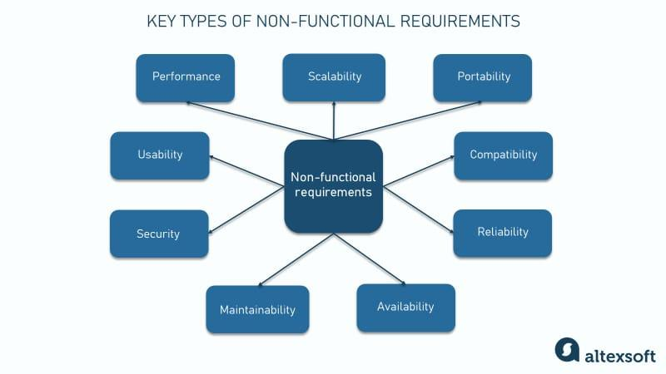
Non-Functional Requirements

Slide 6

User Stories
Team Members
Tasks
Points
Leaderboards
Collaboration
Project Manager
Tasks
Deadlines
Progress

Slide 7
Challenges
Gamification
Real-Time Updates
UI/UX Design
2D Graphics Experience

Slide 8
Next Steps
Finalize Requirements Document
UI Mockups
Project Plan (Timeline)
Database Design
Backend Setup
Basic Front End Development
Prototype

Slide 9
That’s it! Questions?

